Slide 1
LAB - 04

Slide 2
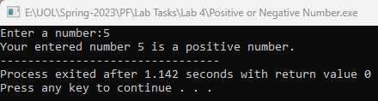
Task - 1
Write a C++ program that input a number from user and display whether it is a positive or negative number.

Slide 3
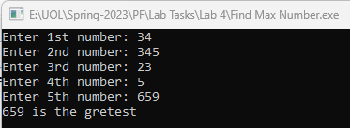
Task - 2
Write a C++ program that input five values from the user and display the maximum number from the list.

Slide 4

Task - 3
Prompt the user to enter the salary and grade of an employee. If the employee has a grade greater than 15 then add 50% bonus to the employee’s salary. Otherwise if the employee’s grade is less than 15 then add 25% bonus to the employee’s salary.

Slide 5


Task - 4
Write a C++ program that accepts a character and determine either the character is a lowercase letter or uppercase letter, also convert lowercase to uppercase and uppercase to lowercase.

Slide 6
Task - 5
Write a program that input the salary of an employee from the user and apply the tax deductions as per a defined policy. The program should compute the tax amount and display the tax and net salary of the user. The defined tax deduction policy is as followings:
No tax should be applied for the employees having 7500 or below salary
5% tax should be applied if salary is more than or equals to 7501 and less than 15000
12 % tax should be applied if salary is more than or equals to 15000 and less than 25000
18 % tax should be applied if salary is more than or equals to 25000 and less than 50000
24 % tax should be applied if salary is more than or equals to 50000 and less than 150000
27 % tax should be applied if salary is more than or equals to 150000 or above

Slide 7


Task - 6
Prompt the user to input a character and display whether it is a vowel or consonant using switch statement.

Slide 8
Task - 7
Write a program that asks the user to input a mathematical operator (+, -, *, /) and two operands, and performs the corresponding mathematical operation using switch statement.
Note: For division if second number is zero then show error message.

Slide 9
Task - 8
In the Chinese calendar, every year is associated with a particular animal. The 12-year animal cycle is rat, ox, tiger, rabbit, dragon, snake, horse, goat, monkey, rooster, dog, and boar. The year 1900 is a year of the rat; thus 1901 is a year of the ox and 1912 is another year of the rat. If you know in what year a person was born, you can compute the offset from 1900 and determine the animal associated with that person's year of birth.
Create a program using SWITCH structure that determines the animal corresponding to an input year of birth. Assume that the input year is 1900 or later. The program should take as input the year of birth in a variable of type int. The program should then display the corresponding animal.

